Slide 1




HTTP Protocol
HTML Forms, HTTP Request and HTTP Responses
HTTP Protocol
SoftUni Team
Technical Trainers
Software University
http://softuni.bg

Slide 2

Table of Contents
HTML Forms
Form action and method
URL
HTTP Overviews
MIME
HTTP Requests
HTTP Responses

Slide 3
Have a Question?
sli.do #JavaWeb

Slide 4



HTML Forms
Form Method and Action

Slide 5


HTML Forms - Action Attribute
Defines where to submit the form data:
<form action="home.html">
<input type="submit" value="Go to homepage"/>
</form>

Slide 6
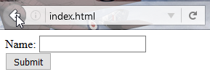
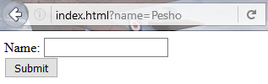
HTML Forms – Method Attribute
Specifies the HTTP method to use when sending form-data
<form method="get"> Name: <input type="text" name="name"> <br>
<input type="submit" value="Submit">
</form>
The form data is in the URL

Slide 7
HTML Forms – Method Attribute (2)
<form method="post"> Name: <input type="text" name="name"> <br>
<input type="submit" value="Submit">
</form>
POST http://localhost/index.html HTTP/1.1
Host: localhost
Content-Type: application/x-www-form-urlencoded
Content-Length: 10
name=Pesho
Headers will be explained later
HTTP request body holds the form data

Slide 8
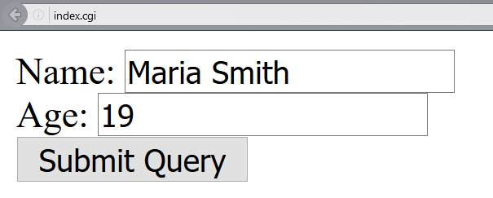
URL Encoded Form Data – Example
<form method="post">
Name: <input type="text" name="name"/> <br/>
Age: <input type="text" name="age"/> <br/>
<input type="submit" />
</form>
POST http://localhost/cgi-bin/index.cgi HTTP/1.1
Host: localhost
Content-Type: application/x-www-form-urlencoded
Content-Length: 23
name=Maria+Smith&age=19
File uploads are not supported

Slide 9

URL
Uniform Resource Locator

Slide 10
Uniform Resource Locator (URL)
http://mysite.com:8080/demo/index.php?id=27&lang=en#lectures
Protocol
Host
Port
Path
Query String
Fragment
URL is a formatted string, consisting of:
Protocol for communicating (http, ftp, https...) – HTTP in most cases
Host or IP address (www.softuni.bg, gmail.com, 127.0.0.1, web)
Port (the default port is 80) – a number in range [0…65535]
Path (/forum, /path/index.php)
Query string (?id=27&lang=en)
Fragment (#lectures) – used on the client to navigate to some section

Slide 11
CGI Script
We will need this Apache CGI script to run a Java class:
chcp 65001
java -Dfile.encoding=UTF8 -Dcgi.content_type=$CONTENT_TYPE -Dcgi.content_length=$CONTENT_LENGTH -Dcgi.request_method=$REQUEST_METHOD -Dcgi.query_string=$QUERY_STRING -cp ./ packageName.className
e.g. softuni.Index
Create a folder with the package name and put the class in it

Slide 12
Query String in Java
A query string is the part of a URL following a question mark (?)
Commonly used in searches and dynamic pages
Accessed in Java through
System.getProperty("cgi.query_string");

Slide 13
URL Encoding
URLs are encoded according RFC 1738:
Safe URL characters: [0-9a-zA-Z], $, -, _, . , +, *, ', (, ), ,, !
All other characters are escaped by:
Space is encoded as "+" or "%20"
Example:
URL-encoded string:
Char | URL Encoding
space | %20
щ | %D1%89
" | %22
# | %23
$ | %24
% | %25
& | %26
%[character hex code]
Наков-爱-SoftUni
%D0%9D%D0%B0%D0%BA%D0%BE%D0%B2-%E7%88%B1-SoftUni

Slide 14
Valid and Invalid URLs – Examples
Some valid URLs:
Some invalid URLs:
http://www.google.bg/search?sourceid=navclient&ie=UTF-8&rlz=1T4GGLL_enBG369BG369&q=http+get+vs+post
http://bg.wikipedia.org/wiki/%D0%A1%D0%BE%D1%84%D1%82%D1%83%D0%B5%D1%80%D0%BD%D0%B0_%D0%B0%D0%BA%D0%B0%D0%B4%D0%B5%D0%BC%D0%B8%D1%8F
Should be: ?q=C%23+.NET+4.0
http://www.google.bg/search?&q=C# .NET 4.0
Should be: ?q=%D0%B1 %D0%B8%D1%80%D0%B0
http://www.google.bg/search?&q=бира

Slide 15
URL Encoding in Java
Use URLEncoder.encode(String, Encoding):
String name = "Some text / някакъв текст";
String urlEncodedText =
URLEncoder.encode(text, "UTF-8");
System.out.println(urlEncodedText);
Some+text+%2F+%D0%BD%D1%8F%D0%BA%D0%B0%D0%BA%D1%8A%D0%B2+%D1%82%D0%B5%D0%BA%D1%81%D1%82

Slide 16
URL Decoding in Java
Use URLDecoder.decode(String, Encoding):
String text = "Some+text+%2F+%D0%BD%D1%8F%D0%BA%D0%B0%D0%BA%D1%8A%D0%B2+%D1%82%D0%B5%D0%BA%D1%81%D1%82"; String urlDecodedText = URLDecoder.decode(text, "UTF-8");
System.out.println(urlDecodedText);
Some text / някакъв текст

Slide 17

MIME and Media Types
Multi-Purpose Internet Mail Extensions

Slide 18
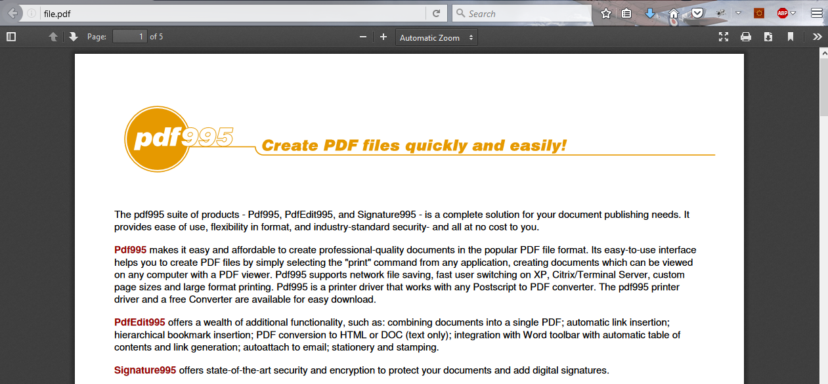
What is MIME?

Slide 19
What is MIME?
MIME == Multi-Purpose Internet Mail Extensions
Internet standard for encoding resources
Originally developed for email attachments
Used in many Internet protocols like HTTP and SMTP
MIME defines several concepts
Content-Type, e.g. text/html, image/gif, application/pdf
Content charset, e.g. utf-8, ascii, windows-1251
Content-Disposition, e.g. attachment; filename=logo.jpg
Multipart messages (multiple resources in a single document)

Slide 20
Common MIME Media Types
MIME Type / Subtype | Description
application/json | JSON data
image/png | PNG image
image/gif | GIF image
text/html | HTML
text/plain | Text
text/xml | XML
video/mp4 | MP4 video
application/pdf | PDF document

Slide 21

HTTP Basics
Request and Responses

Slide 22


Hyper Text Transfer Protocol
Request
Response
HTTP
HTTP
TCP
TCP
IP
IP
Ethernet
Media (wires / air / fiber)
Ethernet
Notes:
HTTP == Hyper Text Transfer Protocol
Client-server protocol for transferring Web resources (HTML files, images, styles, scripts, data, etc.)
The widespread protocol for Internet communication today
Request-response model (client requests, server answers)
Text-based format (human readable)
Relies on unique resource URLs
Provides resource metadata (e.g. encoding)
Stateless (cookies and Web storages can overcome this)

Slide 23
HTTP Request Methods
HTTP defines methods to indicate the desired action to be performed on the identified resource
Method | Description
GET | Retrieve / load a resource
POST | Create / store a resource
PUT | Update a resource
DELETE | Remove a resource

Slide 24
HTTP Conversation: Example
GET /courses/javascript HTTP/1.1
Host: www.softuni.bg
User-Agent: Mozilla/5.0
<CRLF>
HTTP request:
HTTP response:
The empty line denotes the end of the request header
HTTP/1.1 200 OK
Date: Mon, 5 Jul 2010 13:09:03 GMT
Server: Microsoft-HTTPAPI/2.0
Last-Modified: Mon, 12 Jul 2014 15:33:23 GMT
Content-Length: 54
<CRLF>
<html><title>Hello</title>
Welcome to our site</html>
The empty line denotes the end of the response header

Slide 25

HTTP
Tools for Developers

Slide 26
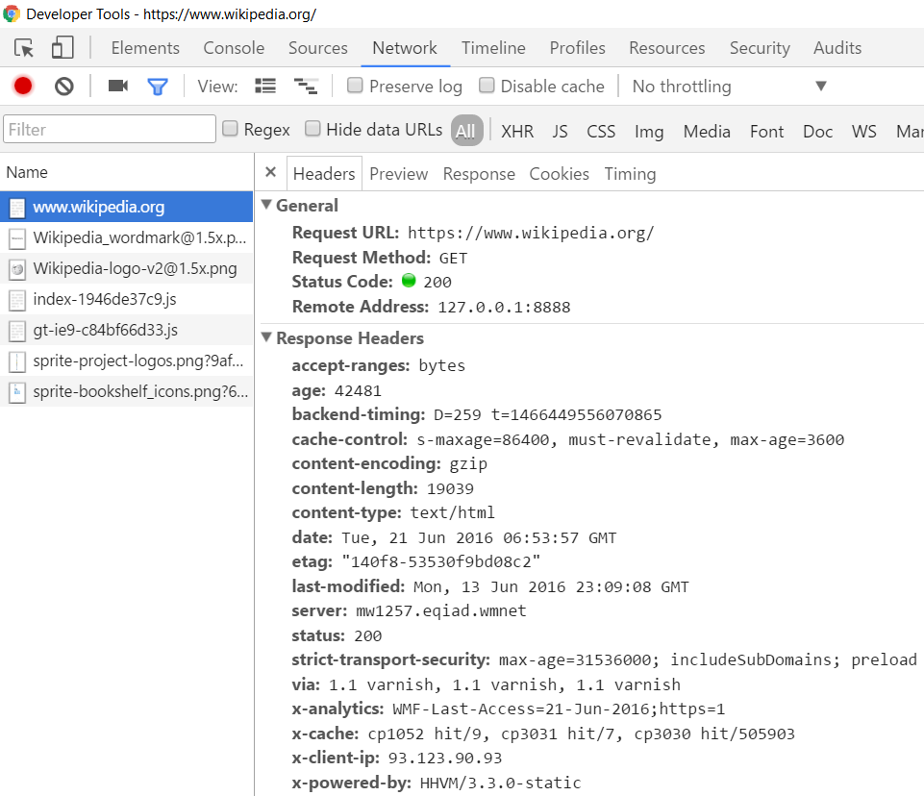
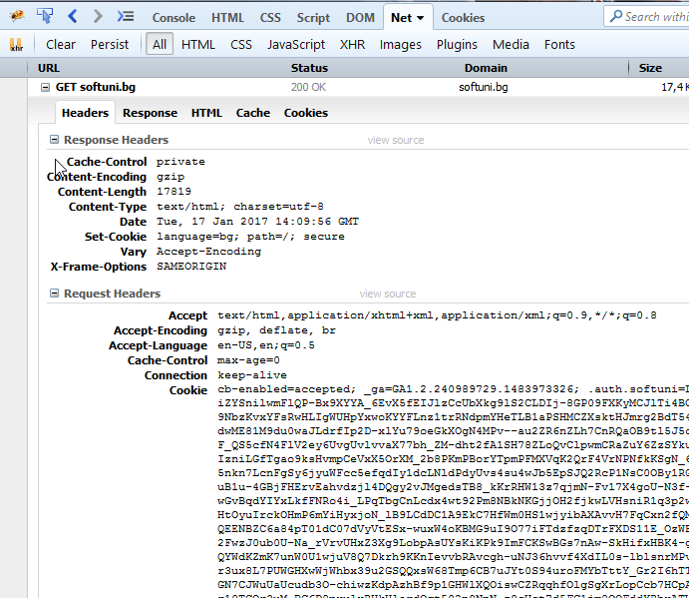
HTTP Tools for Developers - Browser
Chrome Developer Tools
Firebug

Slide 27


HTTP Tools for Developers - Browser (2)
Postman - Chrome
RESTClient - Firefox

Slide 28
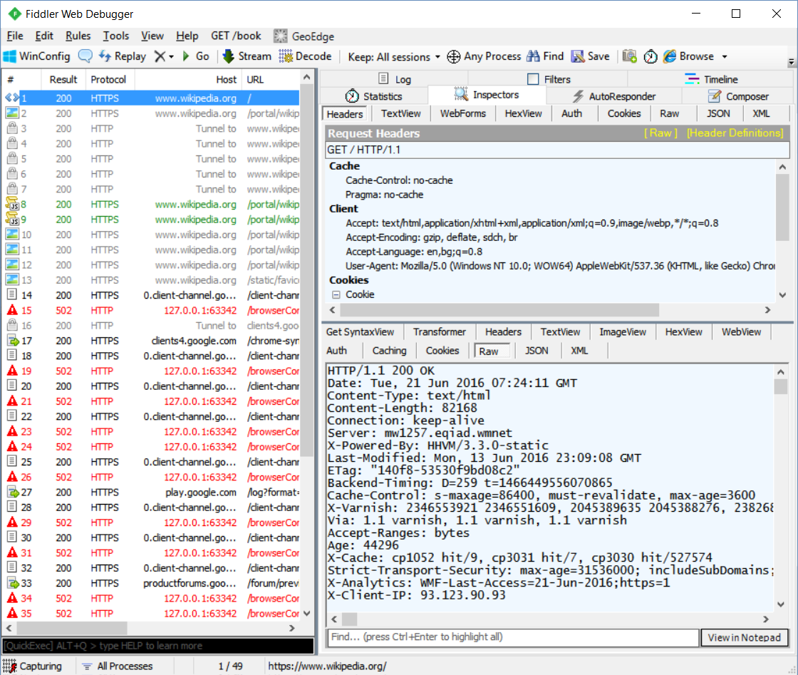
HTTP Tools for Developers - Desktop
Fiddler

Slide 29

HTTP Request
What is a HTTP Request?

Slide 30
HTTP Request Message
Request message sent by a client consists of:
HTTP request line
Request method (GET / POST / PUT / DELETE / …)
Resource URI (URL)
Protocol version
HTTP request headers
Additional parameters
HTTP request body – optional data, e.g. posted form fields
<method> <resource> HTTP/<version>
<headers>
(empty line)
<body>

Slide 31
HTTP POST Request – Example
Example of HTTP POST request:
POST /login.cgi HTTP/1.1
Host: localhost
Content-Length: 59
<CRLF>
username=mente&password=top*secret!
<CRLF>
HTTP request line
HTTP request headers
The request body holds the submitted form data

Slide 32
POST Request Method – Example
The POST method transfers data in the HTTP body
Reading an HTTP POST request data in Java:
<form method="post">
Name: <input type="text" name="name" />
Age: <input type="text" name="age" />
<input type="submit" />
</form>
POST can send text and binary data, e.g. upload files
String requestMethod = System.getProperty("cgi.request_method"); if (requestMethod.equals("post") || requestMethod.equals("POST")) { BufferedReader br = new BufferedReader(
new InputStreamReader(System.in));
String params = br.readLine();
}

Slide 33
HTTP GET Request – Example
Example of HTTP GET request:
HTTP request line
GET /index.cgi HTTP/1.1
Host: localhost
<CRLF>
HTTP request headers
The request body is empty

Slide 34
GET Request Method – Example
<form method="get">
Name: <input type="text" name="name" />
Age: <input type="text" name="age" />
<input type="submit" />
</form>
Reading HTTP GET request data in Java:
String requestMethod = System.getProperty("cgi.request_method"); if (requestMethod.equals("get") || requestMethod.equals("GET")) {
String params = System.getProperty("cgi.query_string"); }

Slide 35

HTTP Response
What is a HTTP Response?

Slide 36
HTTP Response Message
The response message sent by the HTTP server consists of:
HTTP response status line
Protocol version
Status code
Status phrase
Response headers
Provide meta data about the returned resource
Response body
The content of the HTTP response (data)
HTTP/<version> <status code> <status text>
<headers>
<CRLF>
<response body – the requested resource>

Slide 37
HTTP Response – Example
Example of HTTP response from the Web server:
HTTP response status line
HTTP/1.1 200 OK
Date: Fri, 17 Jul 2010 16:09:18 GMT+2
Server: Apache/2.2.14 (Linux)
Accept-Ranges: bytes
Content-Length: 84
Content-Type: text/html
<CRLF>
<html>
<head><title>Test</title></head>
<body>Test HTML page.</body>
</html>
HTTP response headers
HTTP response body

Slide 38
HTTP Response Codes
HTTP response code classes
1xx: informational (e.g., "100 Continue")
2xx: successful (e.g., "200 OK", "201 Created")
3xx: redirection (e.g., "304 Not Modified", "301 Moved Permanently", "302 Found")
4xx: client error (e.g., "400 Bad Request", "404 Not Found", "401 Unauthorized", "409 Conflict")
5xx: server error (e.g., "500 Internal Server Error", "503 Service Unavailable")

Slide 39
HTTP Response – Example
Example of HTTP response with error result:
HTTP response status line
HTTP/1.1 404 Not Found
Date: Fri, 17 Nov 2014 16:09:18 GMT+2
Server: Apache/2.2.14 (Linux)
Connection: close
Content-Type: text/html
<CRLF>
<HTML><HEAD><TITLE>404 Not Found</TITLE></HEAD>
<BODY>
<H1>Not Found</H1>
The requested URL /img/logo.gif was not found on this server.<P> <HR><ADDRESS>Apache/2.2.14 Server at Port 80</ADDRESS>
</BODY></HTML>
HTTP response headers
The HTTP response body

Slide 40
Browser Redirection
HTTP GET requesting a moved URL:
The following HTTP response (301 Moved Permanently) tells the browser to request another URL:
GET / HTTP/1.1
Host: http://softuni.org
User-Agent: Gecko/20100115 Firefox/3.6
<CRLF>
HTTP/1.1 301 Moved Permanently
Location: http://softuni.bg
…

Slide 41
Content-Type and Disposition
The Content-Type response header the server specifies how the output should be processed
Examples:
UTF-8 encoded HTML page. Will be shown in the browser.
Content-Type: text/html; charset=utf-8
Content-Type: application/pdf
Content-Disposition: attachment; filename="Report-April-2016.pdf"
This will download a PDF file named Report-April-2016.pdf

Slide 42
Content-Disposition - Example
File file = new File("text.txt"); String headers = "Content-Type: text/plain\n" +
"Content-Length: " + file.length() + "\n" +
"Content-Disposition: attachment; filename=FILENAME.txt\n"; System.out.println(headers);
BufferedReader br = new BufferedReader(new FileReader(file));
String s = null;
while((s = br.readLine()) != null)
{
System.out.println(s);
}
On download the user will see this file name
Read the file and print it

Slide 43
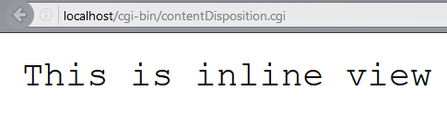
Content-Disposition – Example (2)
File file = new File("text.txt"); String headers = "Content-Type: text/plain\n" +
"Content-Length: " + file.length() + "\n" +
"Content-Disposition: inline; filename=readme.txt\n"; System.out.println(headers);

Slide 44
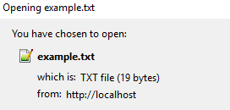
Content-Disposition – Example (3)
File file = new File("text.txt"); String headers = "Content-Type: text/plain\n" +
"Content-Length: " + file.length() + "\n" +
"Content-Disposition: attachment; filename=example.txt\n";
System.out.println(headers);

Slide 45

Summary
HTML forms can send 2 types of HTTP requests: GET and POST
HTTP works with message pairs called HTTP request and HTTP response
HTTP headers describe the request / response metadata
See the most used headers here
The URL parts define:
protocol, host, port, path, query string, and fragment

Slide 46








HTTP Protocol
https://softuni.bg/courses/java-web-development-basics

Slide 47
License
This course (slides, examples, demos, videos, homework, etc.) is licensed under the "Creative Commons Attribution-NonCommercial-ShareAlike 4.0 International" license

Slide 48




Trainings @ Software University (SoftUni)
Software University – High-Quality Education, Profession and Job for Software Developers
softuni.bg
Software University Foundation
softuni.org
Software University @ Facebook
facebook.com/SoftwareUniversity
Software University Forums
forum.softuni.bg

